Slide 1
Knowledge Guided Short-Text Classification For Healthcare Applications
Advisor: Jia-Ling, Koh
Source: 2017 IEEE International Conference on Data Mining
Speaker: Shao-wei, Huang
Date: 2018/11/26

Slide 2
Outline
Introduction
Method
Experiment
Conclusion

Slide 3
Outline
Introduction
Method
Experiment
Conclusion

Slide 4
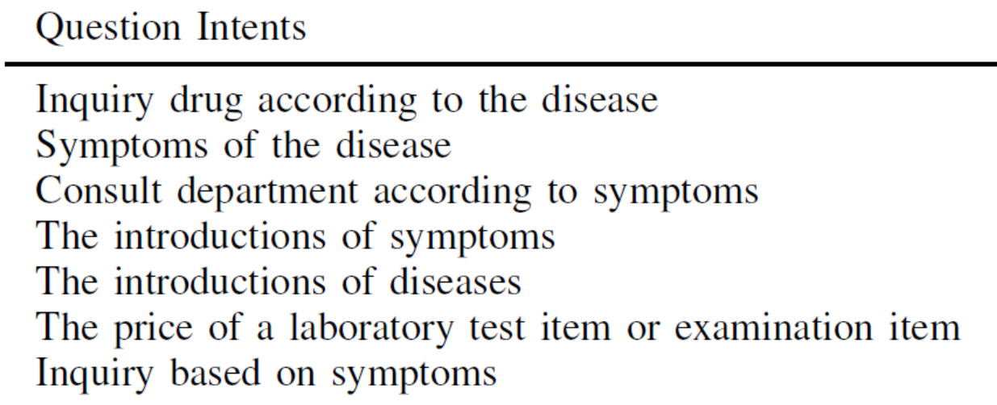
Introduction
Short-Text classification for health application.
(Ex)

Slide 5
Introduction
Challenges
There may not be enough information that we can extract from the individual meaning of words.
Medical concepts are extremely unevenly distributed. This makes learning an unbiased embedding challenge.
DKGAM
DOMAIN KNOWLEDGE GUIDED ATTENTION MODEL

Slide 6
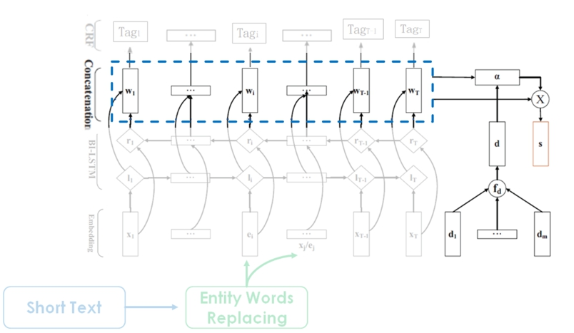
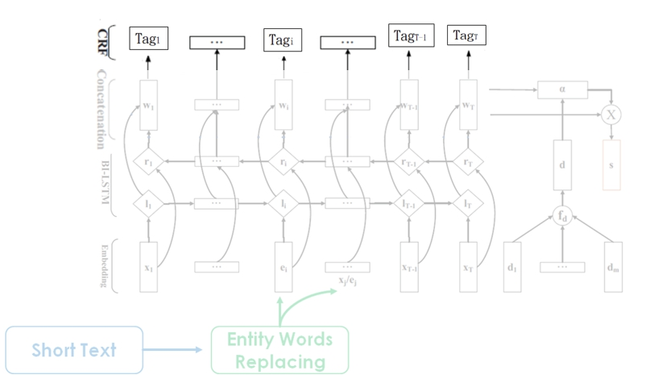
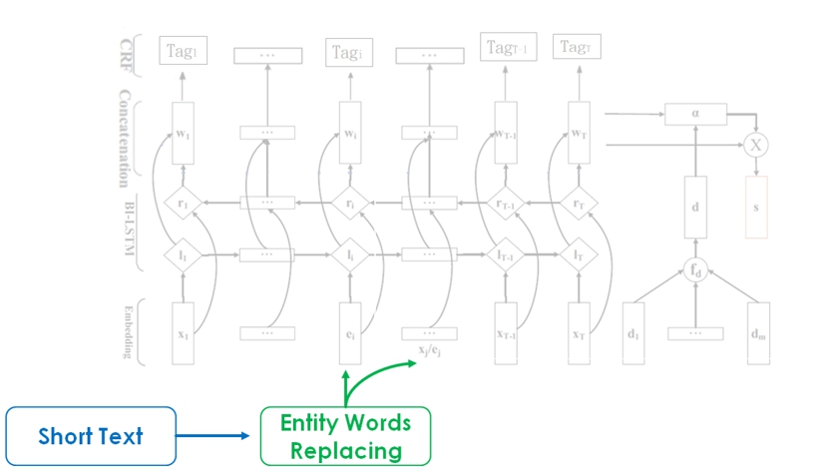
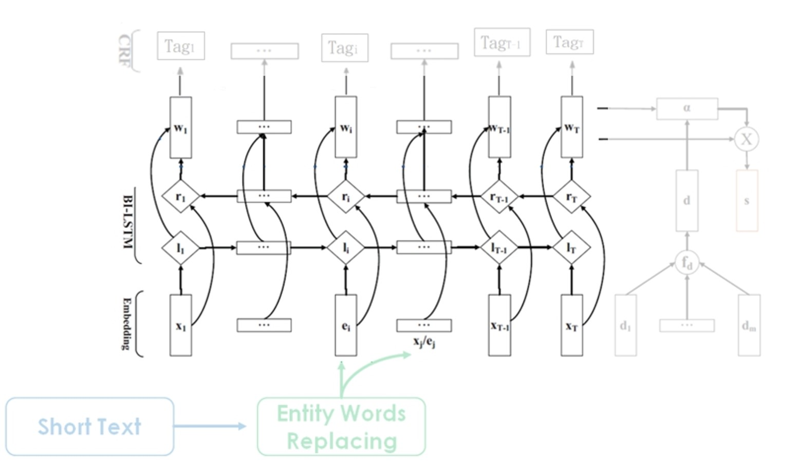
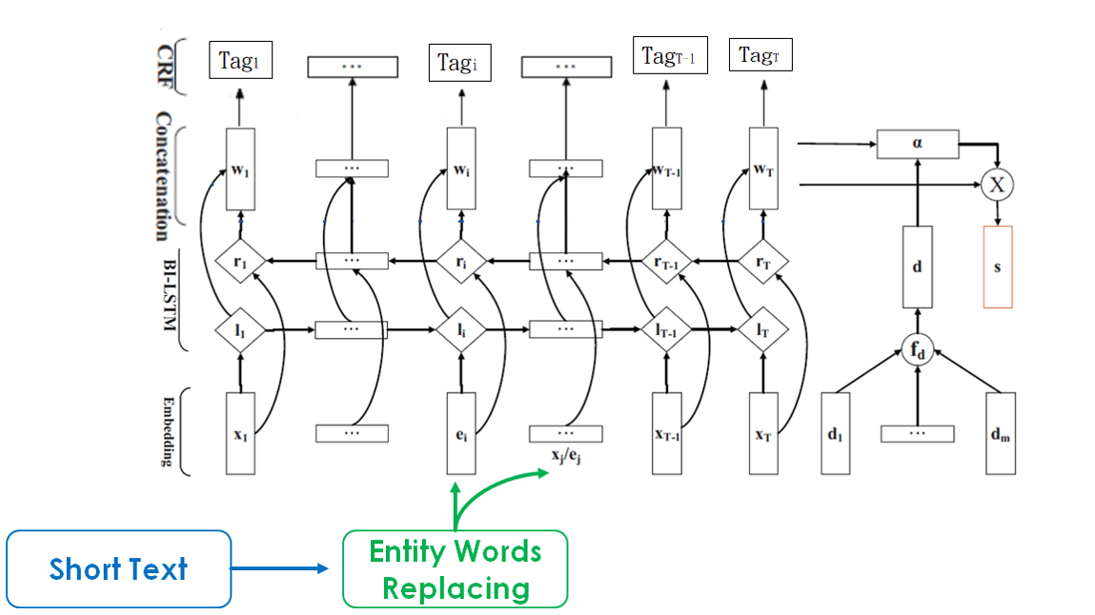
FRAMEWORK
Training

Slide 7
Outline
Introduction
Method
Experiment
Conclusion

Slide 8
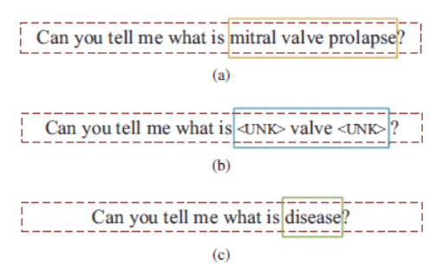
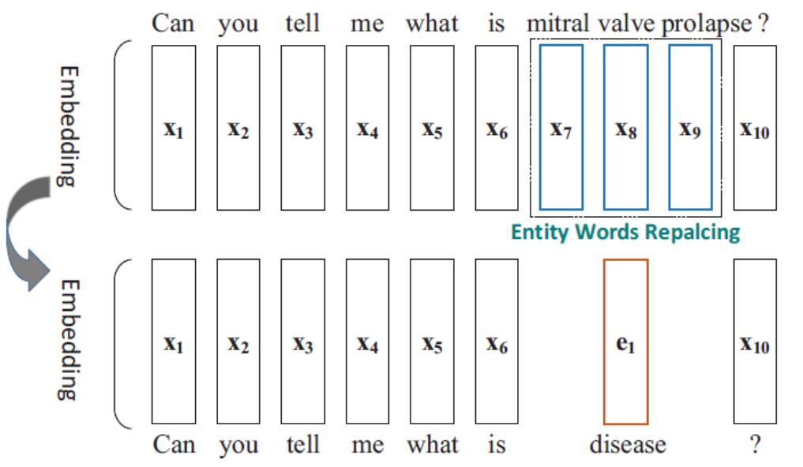
Method
Entity words replacing
Use the entity type embeddings to replace the entity words embeddings.

Slide 9
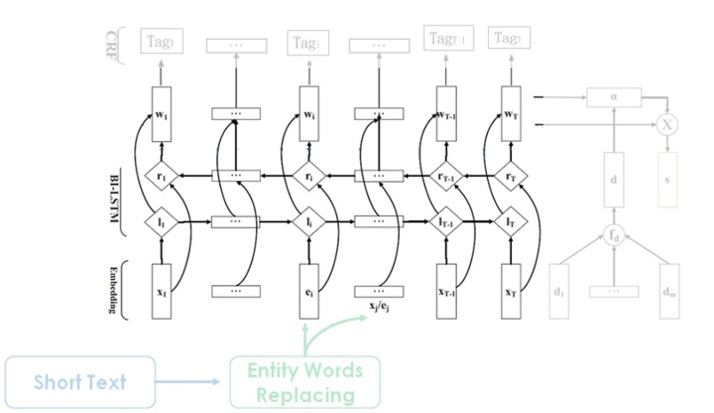
Method
Bidirectional LSTM
At each time step, the final word representation $w_{t}$ = [$l_{t};r_{t}$].

Slide 10
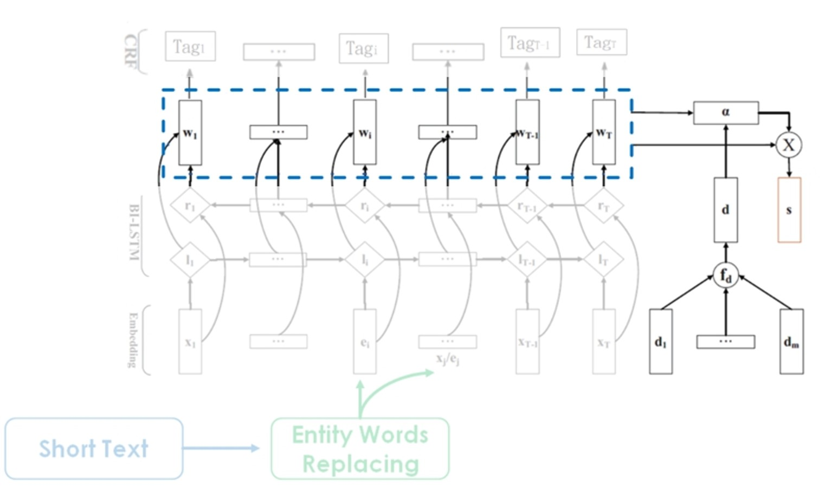
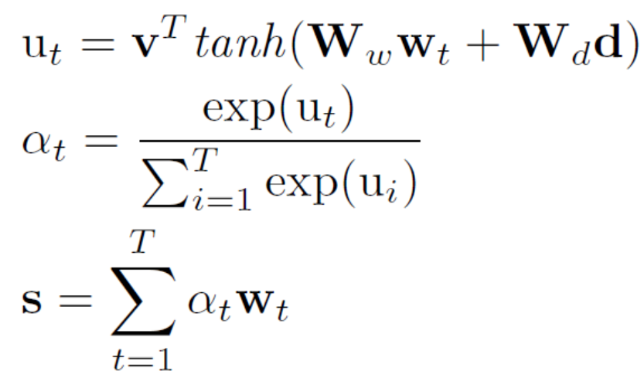
Method
Attention Model
Attention mechanism:
Loss function:
Ww
Wd
d = $f_{d}$($d_{1}$, $d_{2}$, … , $d_{m}$ )
d V.S e

Slide 11
Method
Attention Model-
Regularization of
Entity Type Embeddings
We expect the type embeddings(d) to be distinguishable, we
add a cosine similarity regularization term on it.
Loss function:
DKGAM =
Entity words replacing + Bidirectional LSTM + Attention Model

Slide 12
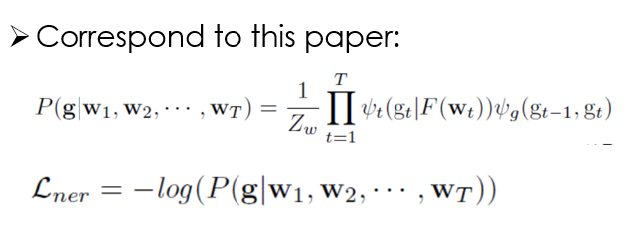
Method
Name Entity Recognition
(add the CRF layer)

Slide 13
Method
Multi-task Strategy
MT-DKGAM =
Entity words replacing + Bidirectional LSTM + Attention Model
+ Name Entity Recognition
Use μ to balance the importances of the entity proposals and hidden vectors.
Loss function:

Slide 14
Outline
Introduction
Method
Experiment
Conclusion

Slide 15
EXPERIMENT
Dataset
COHCP:
1298 labeled questions belong to 7 categories which are also the patient most cared about.
ATIS:
The training set contains 4978 utterances and the test set contains 893 utterances.
There are in total 38 distinct entity types and 14 different intent types.

Slide 16
EXPERIMENT

Slide 17
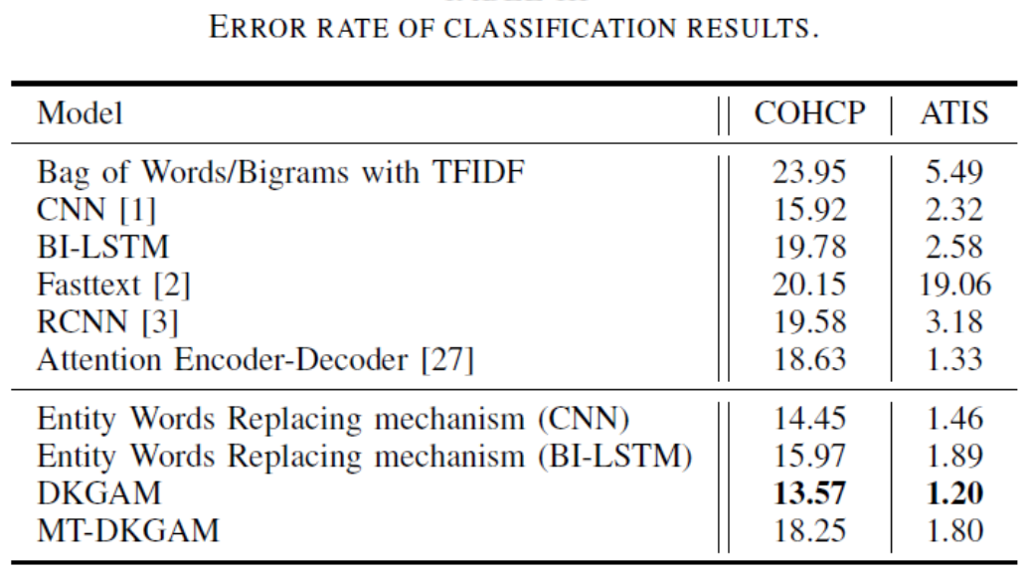
EXPERIMENT
Entity Words Replacing mechanism: Entity Words Replacing used on the CNN and BI-LSTM model.
Fasttext: Employs the n-gram features which are embedded, and averaged into a text
representation.

Slide 18
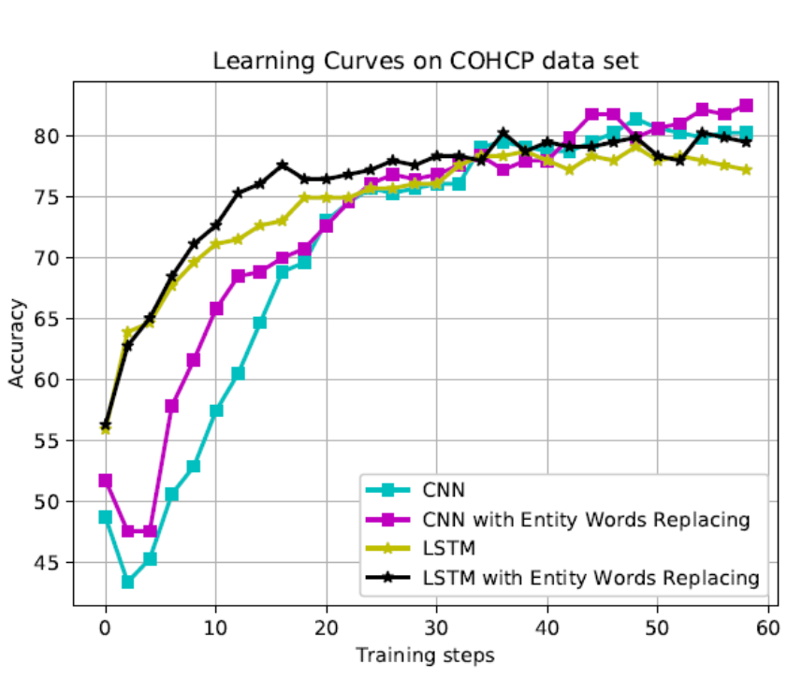
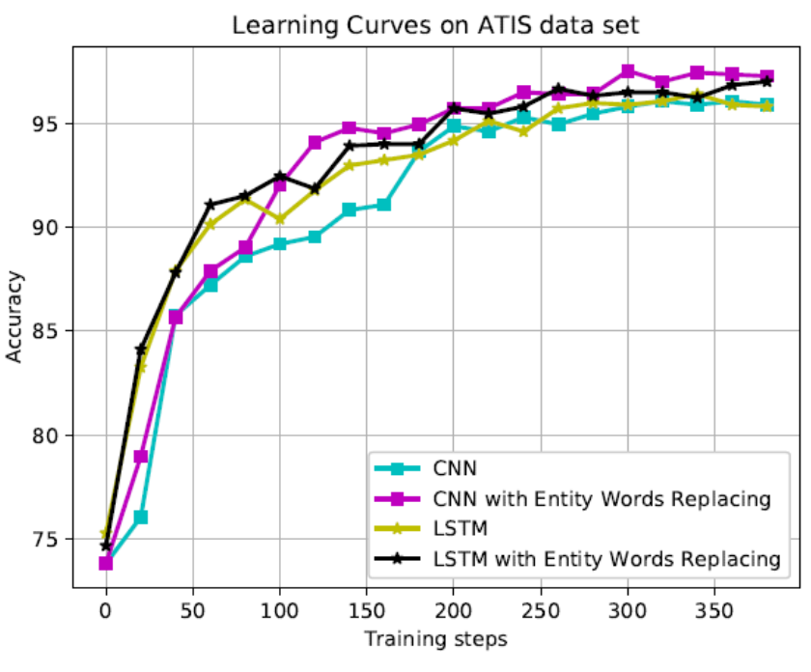
EXPERIMENT

Slide 19
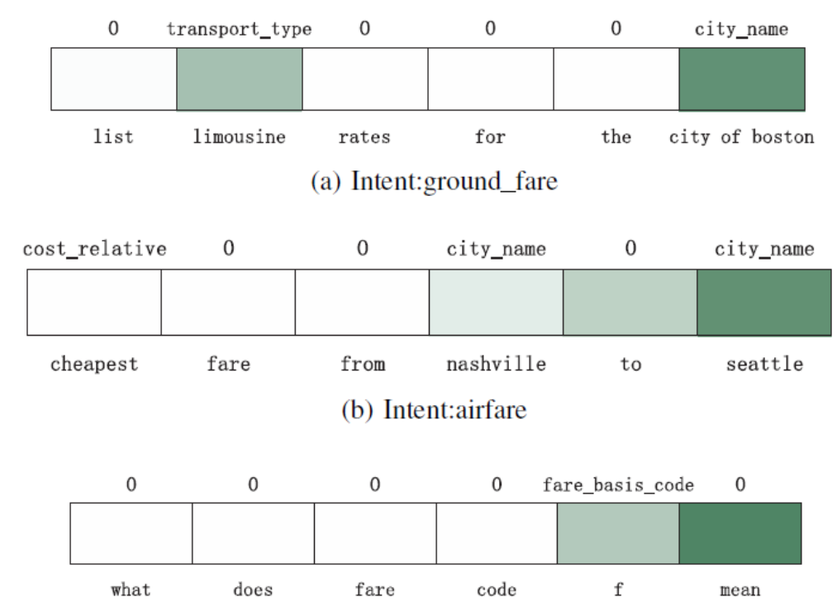
EXPERIMENT

Slide 20
Outline
Introduction
Method
Experiment
Conclusion

Slide 21
Conclusion
Proposed an Entity Words Replacing mechanism to remedy the impact of lacking embeddings of unrecognized entity words so as to utilize the available information more efficiently.
Proposed a domain knowledge guided attention model which aims to utilize the domain knowledge dictionary at hand to refine the classification performance.
Develop a multi-task model to jointly learn the domain knowledge dictionary and do the classification task.

